Slide 1

MLR, LASSO, and Machine learning Models for modeling mlb salaries
By Cassidy Allen
MS Paper Statistics Presentation
Spring 2026
University of Akron

Slide 2



Agenda
Introduction
Data Description & EDA
Methodology
Real Data Analysis
Simulation Study
Conclusion & Discussion

Slide 3

Introduction, data description, and eda
Best Mascot in the Country

Slide 4
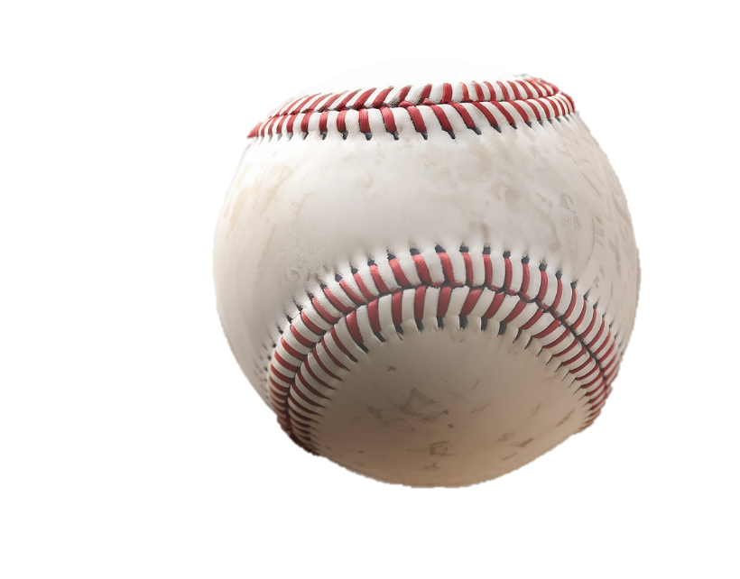
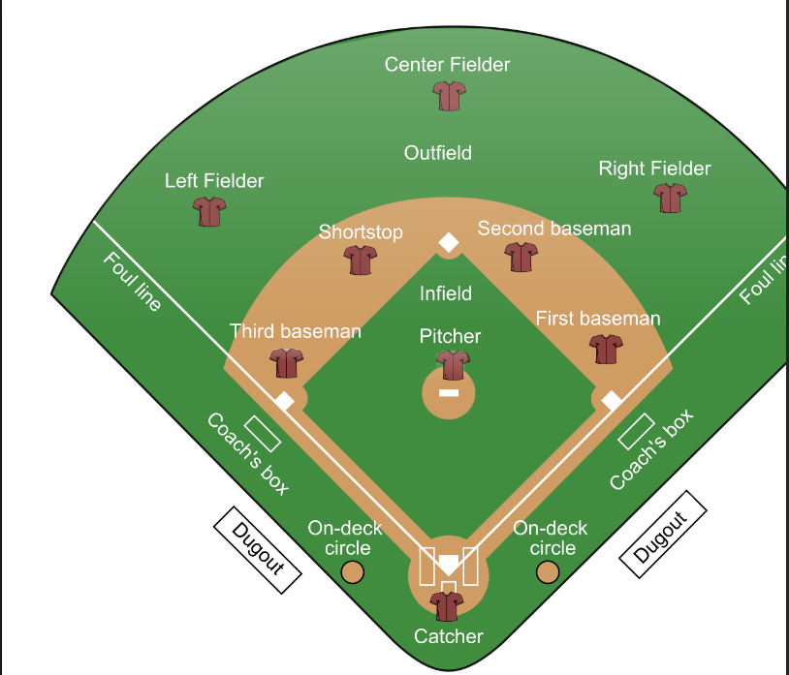
What is baseball?
Sport played on various levels
Focused on Major League Baseball
  30 teams
1869 was year it was founded
1903 was year it became more modernized
  AL/NL divide
  First WS

Slide 5







Motivation
MLB Salaries exploding
Ohtani $700 million, Soto $765 million
Key Question: Can a predictive-based framework be developed to evaluate salary efficiency in MLB?

Slide 6

Research Questions
What performance and experience factors explain salary?
How do differing modeling approaches compare in predictive performance?
Which players are overpaid or underpaid relative to their predictive salaries?

Slide 7

Research Questions
What performance and experience factors explain salary?
How do differing modeling approaches compare in predictive performance?
Which players are overpaid or underpaid relative to their predictive salaries?

Slide 8
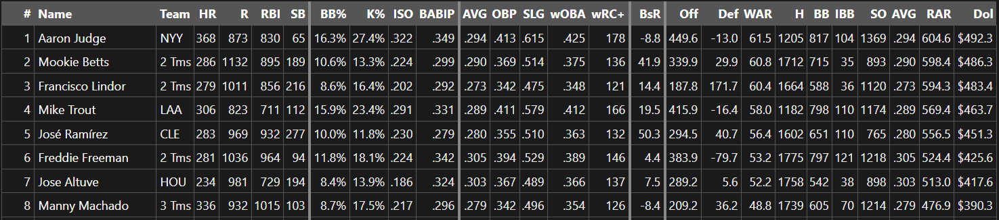

Data
- 205 players (Shohei Ohtani has been banned from this data set)
- Position Players only…no Pitchers/pitching stats accounted for
- 2015-present data
- Source: FanGraphs
- Uploaded into both Minitab and R
- Data was collected in January—only includes players that had major league contracts at that point (no arbitration or minor league deals were included)

Slide 9
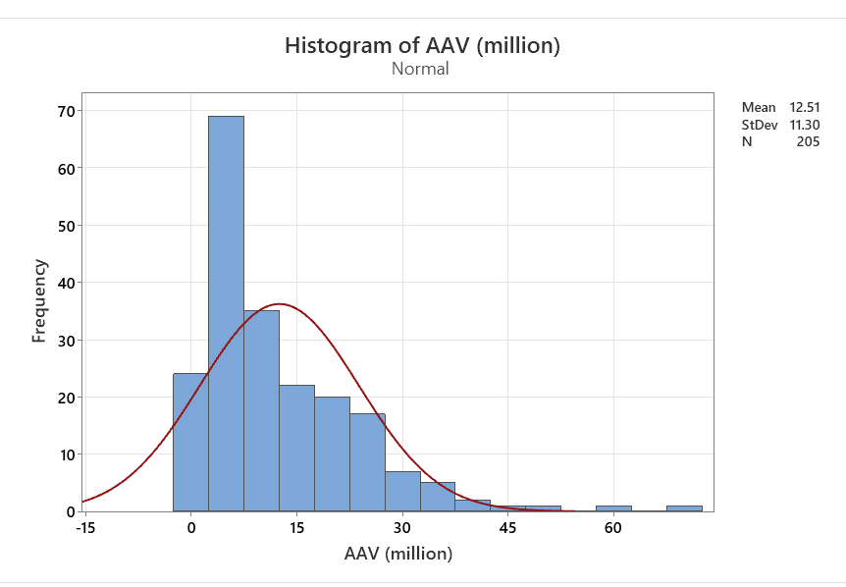
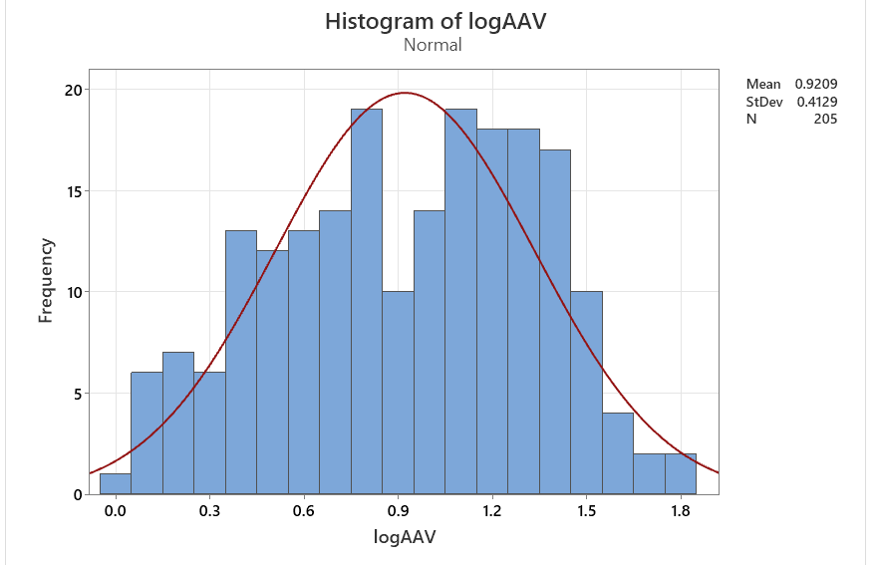
Response Variable
AAV (average annual salary)
right skewed
  log transformation

Slide 10
Indicator variable—position
Variable | Position | N | N* | Mean | SE Mean | StDev
AAV (million) | 1 | 22 | 0 | 10.1943 | 1.34081 | 6.28897
AAV (million) | 2 | 13 | 0 | 11.0018 | 2.98582 | 10.7655
AAV (million) | 3 | 13 | 0 | 14.8429 | 3.06253 | 11.0421
AAV (million) | 4 | 29 | 0 | 13.4859 | 1.92777 | 10.3814
AAV (million) | 5 | 27 | 0 | 18.1659 | 2.21031 | 11.4851
AAV (million) | 6 | 100 | 0 | 10.5353 | 1.05941 | 10.5941
This is based on what position the players were designated at signing
1 = C | 2 = 1B | 3 = 2B | 4 = 3B | 5 = SS | 6 = OF

Slide 11
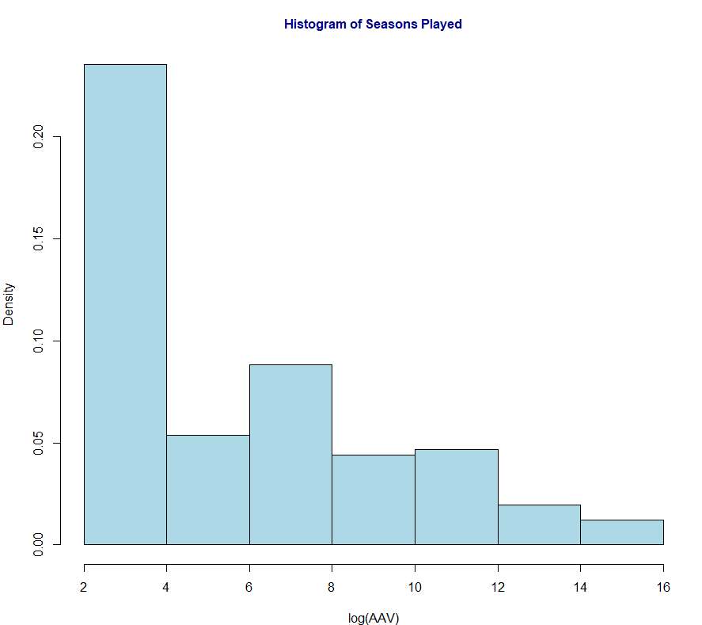

Seasons Played
Players with limited experience are underrepresented as mentioned prior
Distribution is slightly right skewed
Most players have between 3-8 seasons of experience

Slide 12
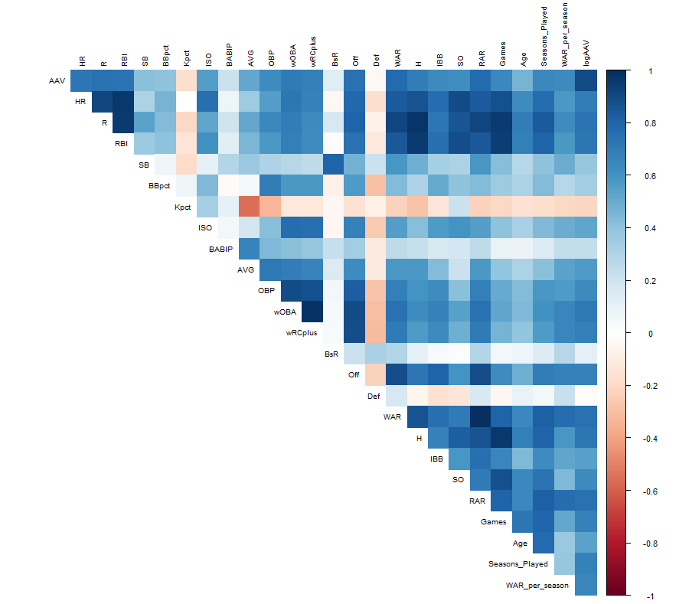
Correlation Heatmap
Offensive production variables (R, RBI, HR, H) and Rate based metrics (AVG, WAR) are positively correlated with AAV
This reveals multicollinearity among predictors
The primary goal of this paper was to predict the overpaid and underpaid players, so multicollinearity is not a main concern and won’t impact predictions.

Slide 13
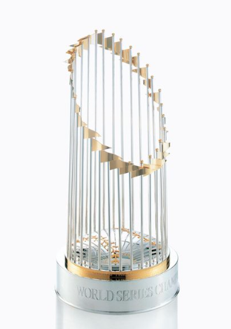
Methodology & real data analysis
MLR, Lasso, Best Subsets, Machine Learning,

Slide 14
Full MLR Model
Predictor | Coefficient | Std. Error | t-value | p-value
(Intercept) | -1.7476 | 1.2205 | -1.4318 | 0.15398
HR | -0.00474 | 0.00191 | -2.4858 | 0.01386
R | 0.0000814 | 0.000827 | 0.0984 | 0.92170
RBI | 0.000881 | 0.000684 | 1.2884 | 0.19930
SB | 0.000746 | 0.000771 | 0.9681 | 0.33432
BBpct | -0.8679 | 2.5159 | -0.3450 | 0.73053
Kpct | 1.3926 | 2.4584 | 0.5665 | 0.57180
ISO | 2.0719 | 7.1809 | 0.2885 | 0.77328
BABIP | -8.8821 | 5.0331 | -1.7647 | 0.07935
AVG | 16.6208 | 9.1286 | 1.8207 | 0.07036
OBP | 3.2254 | 12.9489 | 0.2491 | 0.80359
wOBA | -2.9893 | 21.9361 | -0.1363 | 0.89176
wRCplus | 0.001999 | 0.006546 | 0.3053 | 0.76046
BsR | -0.00183 | 0.003057 | -0.5981 | 0.55052
Off | -0.00338 | 0.005045 | -0.6694 | 0.50410
Def | -0.00317 | 0.005330 | -0.5948 | 0.55276
WAR | 0.03485 | 0.05294 | 0.6583 | 0.51119
H | -0.00105 | 0.000659 | -1.5858 | 0.11459
IBB | -0.000615 | 0.002161 | -0.2845 | 0.77637
SO | 0.000987 | 0.000271 | 3.6387 | 0.00036
Games | 0.000146 | 0.000439 | 0.3336 | 0.73905
Position2 | -0.00924 | 0.08390 | -0.1102 | 0.91240
Position3 | 0.1406 | 0.08380 | 1.6778 | 0.09518
Position4 | 0.06972 | 0.06659 | 1.0469 | 0.29656
Position5 | 0.03152 | 0.07010 | 0.4496 | 0.65353
Position6 | 0.04515 | 0.05583 | 0.8088 | 0.41973
Age | -0.01665 | 0.009142 | -1.8215 | 0.07024
Seasons_Played | 0.03619 | 0.01501 | 2.4116 | 0.01692
WAR_per_season | 0.07472 | 0.03550 | 2.1051 | 0.03671
Main emphasis focuses on predictive performance rather than coefficient interpretation

Slide 15
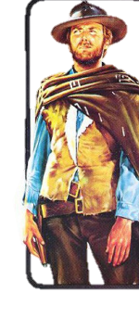
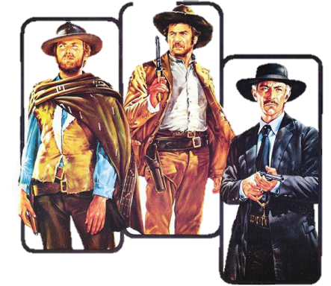

MLR Model – Good, bad, and sort of ugly
More concerned with predictive power over individual interpretability
Good baseline and starting point, leaves room for improvement with other statistical models.
- $R^{2}$ = 0.7404
- $R^{2}$ (adj) = 0.698
Overall model is statistically significant (p < 0.001)
- Caution should be exercised when interpretating coefficients
- Limited interpretability of model

Slide 16
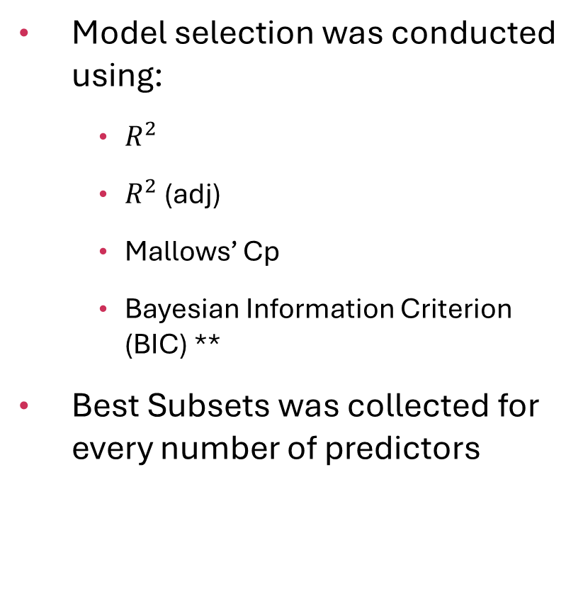
Best Subsets method
Model selection was conducted using:
  $R^{2}$
  $R^{2}$ (adj)
  Mallows’ Cp
  Bayesian Information Criterion (BIC) **
Best Subsets was collected for every number of predictors
Num Predictors | R² | Adj R² | Cp | BIC
5 | 0.7003 | 0.6927 | 9.4003 | -213.8867
6 | 0.7139 | 0.7052 | 2.2248 | -218.0809
7 | 0.7187 | 0.7086 | 1.0492 | -216.1611
8 | 0.7223 | 0.7109 | 0.6249 | -213.4759
29 | 0.7410 | 0.6979 | 30.0000 | -116.0846

Slide 17
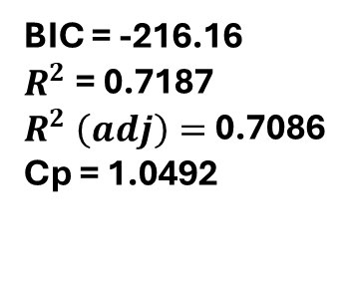
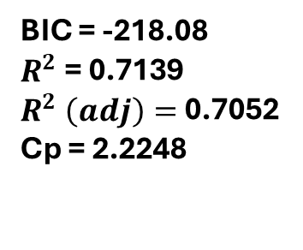
Best (and first loser) model
Predictor | Coefficient
(Intercept) | -1.1172
HR | -0.0026
BABIP | -6.4669
AVG | 9.6650
SO | 0.0010
wRCplus | 0.0105
Def | 0.0015
Predictor | Coefficient
(Intercept) | -1.1597
HR | -0.0034
BABIP | -5.9360
AVG | 11.0869
SO | 0.0009
ISO | 2.6669
Seasons_Played | 0.0295
WAR_per_season | 0.0851
BIC = -218.08
$R^{2}$= 0.7139
$R^{2} \left(adj\right)=$0.7052
Cp = 2.2248
BIC = -216.16
$R^{2}$= 0.7187
$R^{2} \left(adj\right)=$0.7086
Cp = 1.0492

Slide 18
Technically, size 6 model is the best using bic
Predictor | Coefficient
(Intercept) | -1.1172
HR | -0.0026
BABIP | -6.4669
AVG | 9.6650
SO | 0.0010
wRCplus | 0.0105
Def | 0.0015
Predictor | Coefficient
(Intercept) | -1.1597
HR | -0.0034
BABIP | -5.9360
AVG | 11.0869
SO | 0.0009
ISO | 2.6669
Seasons_Played | 0.0295
WAR_per_season | 0.0851
BIC = -218.08
$R^{2}$= 0.7139
$R^{2} \left(adj\right)=$0.7052
Cp = 2.2248
BIC = -216.16
$R^{2}$= 0.7187
$R^{2} \left(adj\right)=$0.7086
Cp = 1.0492

Slide 19

However, the ‘first loser’ model was selected as final model for best subsets
Predictor | Coefficient
(Intercept) | -1.1172
HR | -0.0026
BABIP | -6.4669
AVG | 9.6650
SO | 0.0010
wRCplus | 0.0105
Def | 0.0015
Predictor | Coefficient
(Intercept) | -1.1597
HR | -0.0034
BABIP | -5.9360
AVG | 11.0869
SO | 0.0009
ISO | 2.6669
Seasons_Played | 0.0295
WAR_per_season | 0.0851
There is a slightly improved fit
The Cp is lower than the size 6 model
The BIC, while slightly larger, is very negligible
This model provides an extra parameter
BIC = -218.08
$R^{2}$= 0.7139
$R^{2} \left(adj\right)=$0.7052
Cp = 2.2248
BIC = -216.16
$R^{2}$= 0.7187
$R^{2} \left(adj\right)=$0.7086
Cp = 1.0492

Slide 20
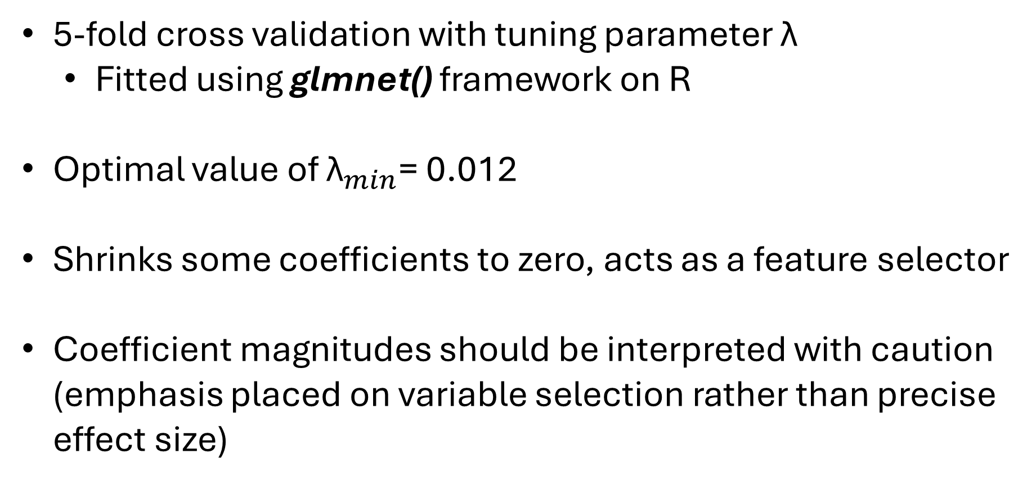
Lasso regression
5-fold cross validation with tuning parameter λ
  Fitted using glmnet() framework on R
Optimal value of ${\text{λ}}_{min}$= 0.012
Shrinks some coefficients to zero, acts as a feature selector
Coefficient magnitudes should be interpreted with caution (emphasis placed on variable selection rather than precise effect size)

Slide 21
Lasso regression
Predictor | Coefficient
(Intercept) | -0.3465
Kpct | -0.7250
ISO* | 0.1056
AVG* | 1.5994
wOBA | 0.1642
wRCplus | 0.0040
SO* | 0.0003
Position2 | -0.0554
Position3 | 0.0550
Seasons_Played* | 0.0226
WARperseason* | 0.0755
Provides stability and robustness in the presence of correlated variables
A lot of the same variables from Best subsets appeared in LASSO, strengthening confidence in reliability of identified salary drivers
Handles Multicollinearity the best

Slide 22
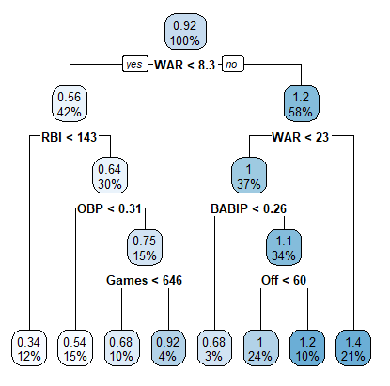
Exploration of nonlinearity and interactions
Initial split separates players based on overall performance, with higher predicted salaries associated with higher WAR values
Provides evidence of nonlinear relationships not fully captured by linear models
Suggests the presence of interaction effects not considered for the project

Slide 23
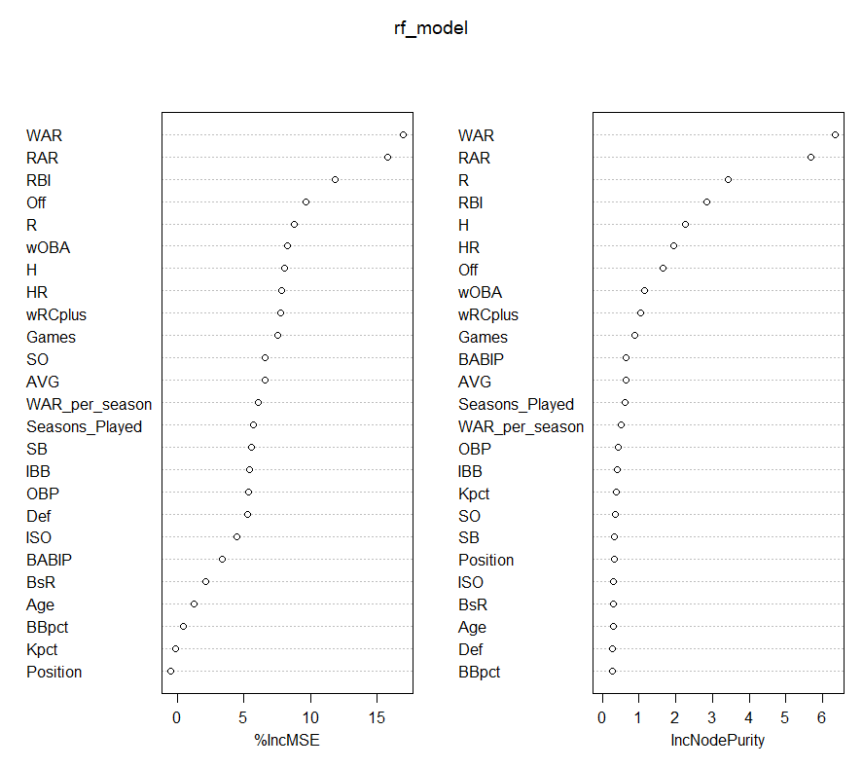
Machine learning – random forest
WAR is the most important predictor of salary
RBI, R, and wOBA are highly influential
Games played and season played contributed to a lesser extent
Age, position, and BsR exhibit relatively low importance
Reinforces the variables chosen in linear models

Slide 24
Which model is best?

Slide 25
Model comparison
Model | RMSE
Full MLR | 0.24955
Best Subset: Best Model (BIC) | 0.24805
Best Subset: Second Best (Size 7) | 0.23929
LASSO | 0.23766
Random Forest | 0.21903
LASSO is selected as the final model for inference and interpretation as it is both predictive and transparent with coefficient-based structure
Despite the strong predictive performance, RF was not selected as the primary model for interpretation due to its limited interpretability
Random Forest model achieved the lowest, likely due to its ability to capture nonlinear relationships and interaction effects

Slide 26
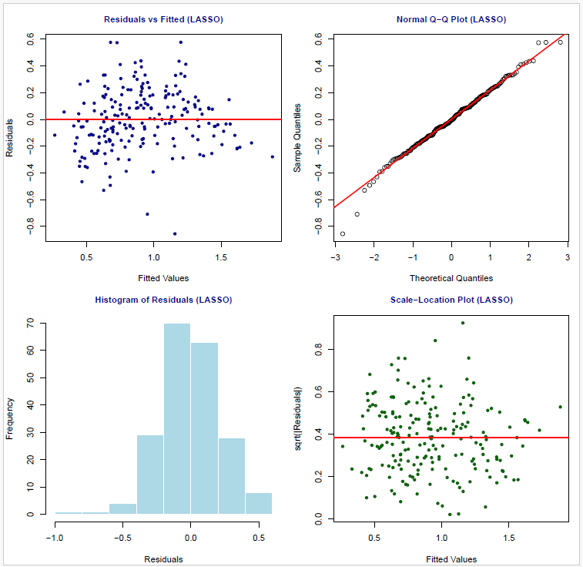
Residuals vs fitted = randomly scattered around zero indicating linear assumption is not violated
Q-Q plot indicates residuals are approximately normal
Histogram of residuals appears roughly symmetric
The spread of residuals remains relatively constant across fitted values = no heteroscedasticity

Slide 27

Model diagnostics

Slide 28
Salary efficiencies
Residuals = actual - predicted
Residuals > 0 = overpaid players
Residuals < 0 = underpaid players

Slide 29
Salary efficiencies – most underpaid lasso
Player | Actual AAV | Predicted AAV | Difference
Aaron Judge | 40.0000 | 75.5384 | -35.5384
Mike Trout | 35.5417 | 53.3392 | -17.7975
Freddie Freeman | 27.0000 | 43.5623 | -16.5623
Bryce Harper | 25.3846 | 41.6289 | -16.2443
Jose Altuve | 25.0000 | 41.0443 | -16.0443
José Ramírez | 20.8000 | 33.2895 | -12.4895
Carlos Santana | 2.0000 | 14.2871 | -12.2871
Eugenio Suárez | 15.0000 | 26.7376 | -11.7376
Ronald Acuña Jr. | 12.5000 | 23.3506 | -10.8506

Slide 30
Salary efficiencies – most overpaid lasso
Player | Actual AAV | Predicted AAV | Difference
Kyle Tucker | 60.0000 | 16.2232 | 43.7768
Cody Bellinger | 44.7500 | 17.7370 | 27.0130
Bo Bichette | 42.0000 | 15.3537 | 26.6463
Anthony Rendon | 35.0000 | 16.0974 | 18.9026
Vladimir Guerrero Jr. | 35.7143 | 17.0604 | 18.6539
Pete Alonso | 31.0000 | 14.8755 | 16.1245
Juan Soto | 51.0000 | 35.5225 | 15.4775
Ha-Seong Kim | 20.0000 | 5.1970 | 14.8030
Trent Grisham | 22.0250 | 7.9049 | 14.1201
Masataka Yoshida | 18.0000 | 4.8336 | 13.1664

Slide 31
Salary efficiencies – most underpaid Random Forest model
Name | Actual AAV | Predicted AAV | Difference
Ronald Acuna Jr. | 12.50 | 18.66 | -6.16
Ketel Marte | 14.64 | 18.78 | -4.13
Ozzie Albies | 7.00 | 10.82 | -3.82
Marcell Ozuna | 12.00 | 15.61 | -3.61
Yandy Diaz | 9.00 | 12.53 | -3.53
Max Muncy | 10.00 | 13.18 | -3.18
Yoan Moncada | 4.00 | 7.06 | -3.06
Jose Rami­rez | 20.80 | 23.86 | -3.06
Carlos Santana | 2.00 | 4.78 | -2.78

Slide 32
Salary efficiencies – most overpaid Random Forest model
Name | Actual AAV | Predicted AAV | Difference
Kyle Tucker | 60.00 | 35.47 | 24.53
Bo Bichette | 42.00 | 26.46 | 15.54
Juan Soto | 51.00 | 36.56 | 14.44
Cody Bellinger | 44.75 | 31.80 | 12.95
Masataka Yoshida | 18.00 | 7.77 | 10.23
Trent Grisham | 22.03 | 13.23 | 8.79
Ha-Seong Kim | 20.00 | 11.79 | 8.21
Anthony Rendon | 35.00 | 26.84 | 8.16
Andreas Gimanez | 19.37 | 12.92 | 6.45

Slide 33

simulation

Slide 34
Purpose and Design
Evaluate the predictive performance and stability of linear and machine learning models under conditions that resemble the MLB salary data
Validate the models and decisions made
Model:
  log(AAV) = β0 + Xβ + ε
  Multicollinearity included

Slide 35
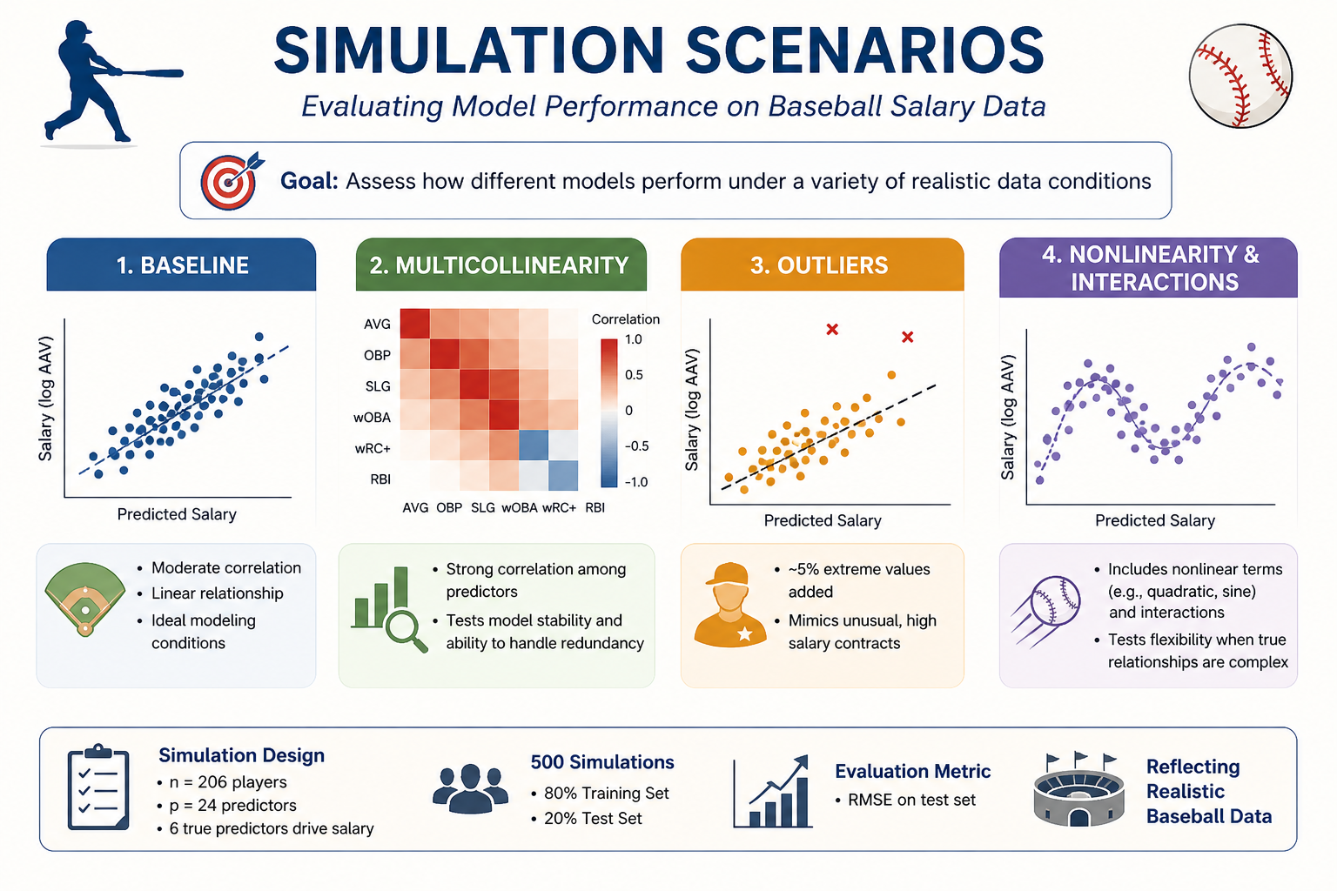

Slide 36
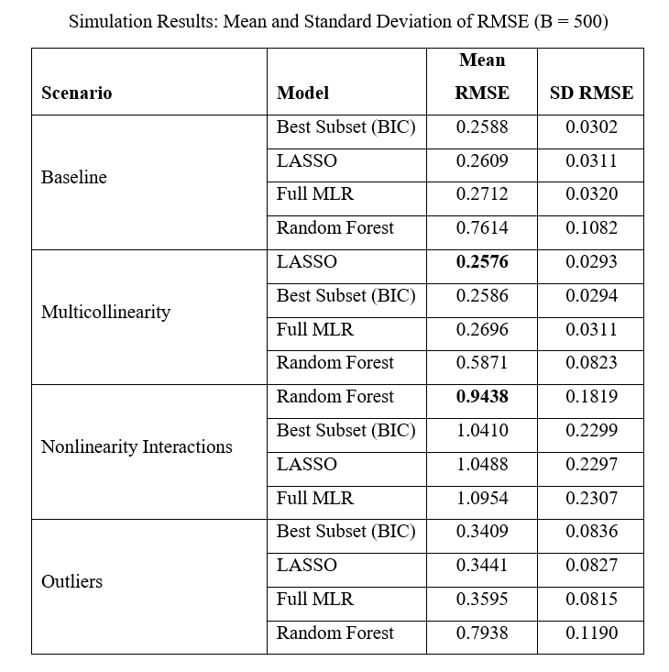
Simulation Results
Key Findings:
  LASSO: best balance (accuracy + stability)
  Best Subset: interpretable
  MLR: sensitive to multicollinearity
  Random Forest: best for nonlinear patterns

Slide 37
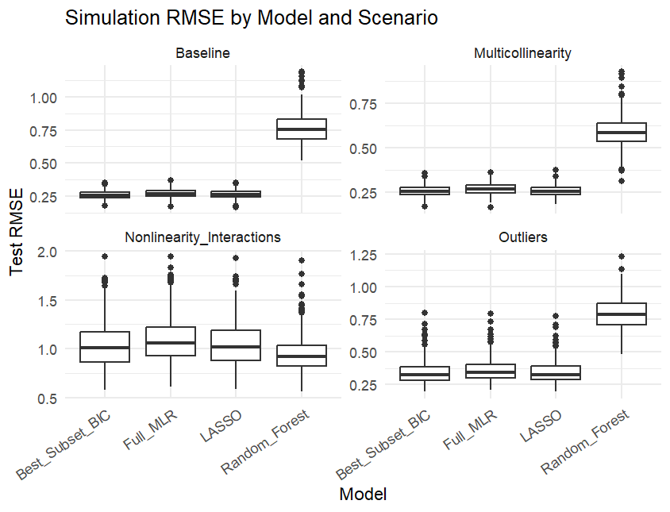
Simulation Results
Random Forest shows higher variability
LASSO is stable and consistent
Linear models perform well in baseline & multicollinearity
RF performs best under nonlinearity
No single model dominates across all scenarios

Slide 38
Simulation results
Simulation confirms that LASSO is the most stable model,
while Random Forest only improves performance under nonlinearity

Slide 39
Conclusion

Slide 40
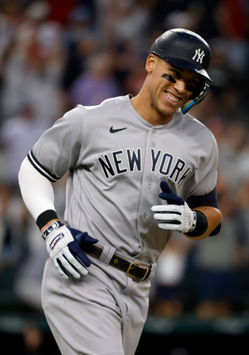
Aaron judge is the best player in baseball
~~~~~~~~~~~~~~~~~~~~~~~
If juan soto would’ve chosen the yankees, he’d be slightly less overpaid right now

Slide 41
Aaron judge is the best player in baseball
~~~~~~~~~~~~~~~~~~~~~~~
If juan soto would’ve chosen the yankees, he’d be slightly less overpaid right now
Just Joking

Slide 42

The real conclusions
Overpaid and underpaid players are largely consistent across models
There are clear discrepancies between predicted and actual salaries
LASSO provides the best overall balance of accuracy and interpretability
Key drivers of salary are consistent across models:
WAR per season, AVG, and experience (seasons played)
No single model dominates:
- LASSO is most stable
- Random Forest performs best under nonlinearity
A simple, interpretable model (LASSO) is sufficient for practical salary evaluation

Slide 43

limitations
Focused on offensive primarily, with minority number of defensive stats, no pitching, or contextual factors (injury history, contract structure, market conditions, etc)
While Random Forest provides indirect evidence of potential nonlinearities and interactions, these effects were not explicitly modeled within the regression framework

Slide 44


Future work
Extend analysis to include pitching performance. Pitching has absolutely exploded in recent years
Incorporate longitudinal data to capture player value over time
Explore additional machine learning methods
Include interaction terms and nonlinear transformations

Slide 45


Thank you! Any questions?
Thank you to my advisor on this project Dr. Nadeesha Jayaweera – I hope you enjoyed learning about baseball this semester!
Thank you to my reader Dr. Einsporn! Sorry the paper was so long…

